Slide 1
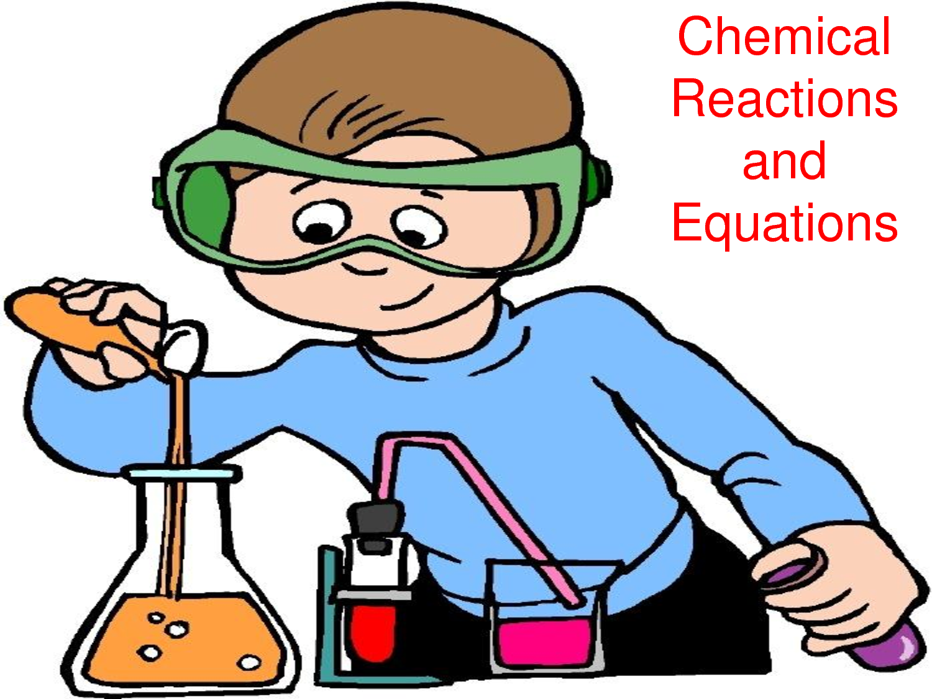
BALANCING & TYPES OF CHEMICAL REACTIONS
Notes:
*

Slide 2
LAW OF CONSERVATION OF MASS
Matter Can Not Be Created or Destroyed!
The MASS of the reactants
EQUALS the MASS of the products
Chemical equation:
NaHCO₃ + HCl H₂O + CO₂ + NaCl
7.0 grams = 7.0 grams
• Elements:
1Na, 2H, 1C, 3O, 1Cl = 1Na, 2H, 1C, 3O, 1Cl

Slide 5
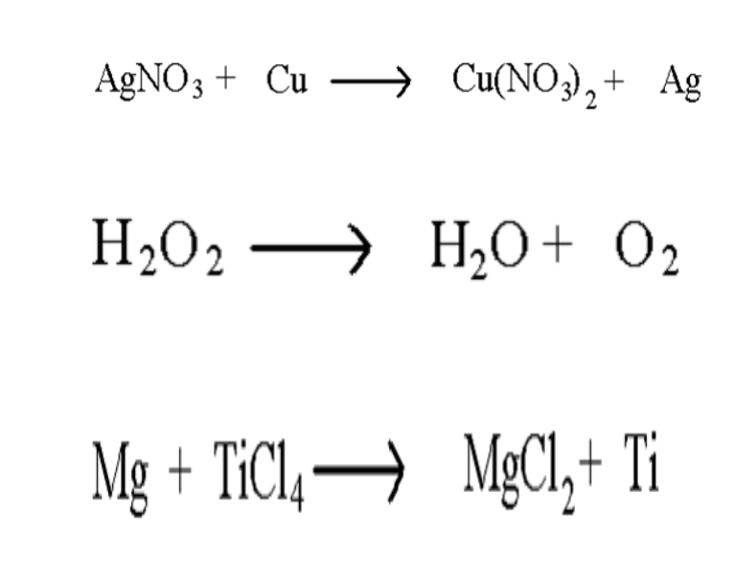

Slide 6
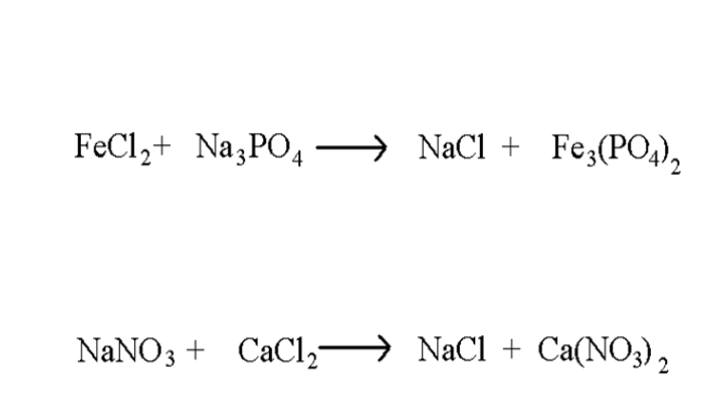

Slide 7
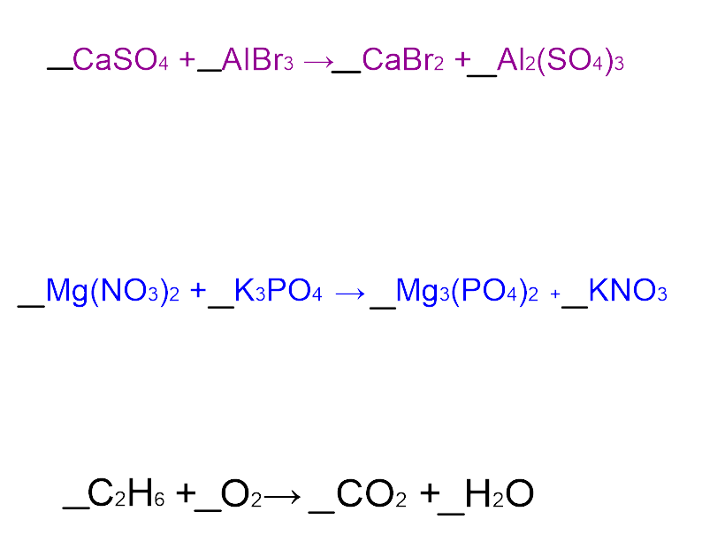

Slide 8
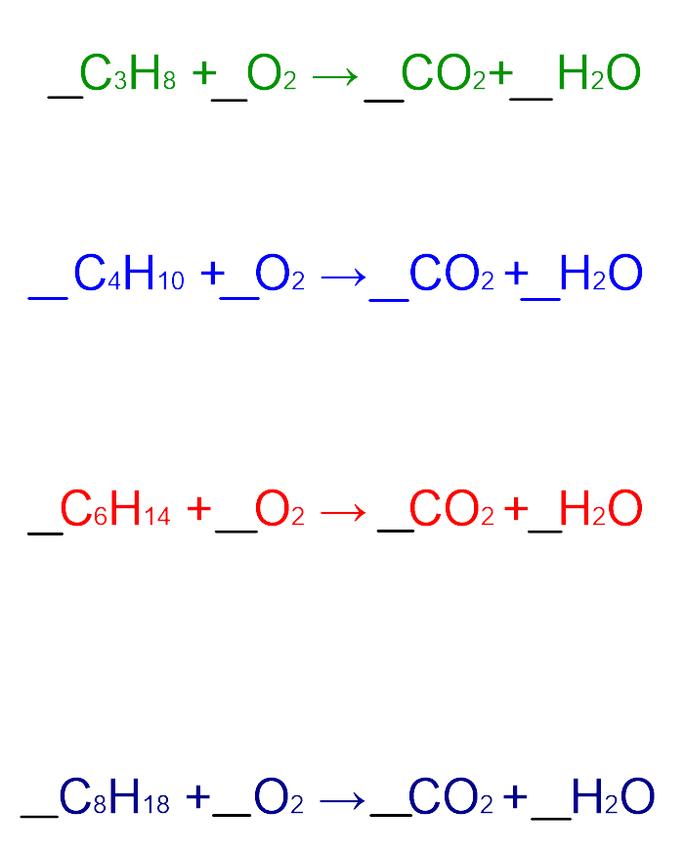

Slide 9
Types of Chemical Reactions
Synthesis
Decomposition
Single Replacement
Double-replacement
Combustion

Slide 10
SYNTHESIS
Two or more parts make a SINGLE product
Na
+
2
2Na
Cl₂
Cl
A + B → AB
Notes:
*

Slide 11
DECOMPOSITION
One reactant gets BROKEN DOWN into two or more parts
+
2H₂O
2H₂
O₂
AB → A + B
Notes:
*

Slide 12
SINGLE REPLACEMENT
A part of the reactant is REPLACED with new atom and the atom that was replaced is now by itself
+
+
Br₂
2NaBr
Cl₂
2NaCl
SINGLE REPLACEMENT
AB + C → AC + B
Notes:
*

Slide 13
DOUBLE REPLACEMENT
The cations and the anions in the reactants switch partners forming 2 new compounds. No element is left uncombined.
+
+
CuSO₄
2NaOH
Cu(OH)₂
Na₂SO₄
AB + CD → AD + CB
Notes:
*

Slide 14
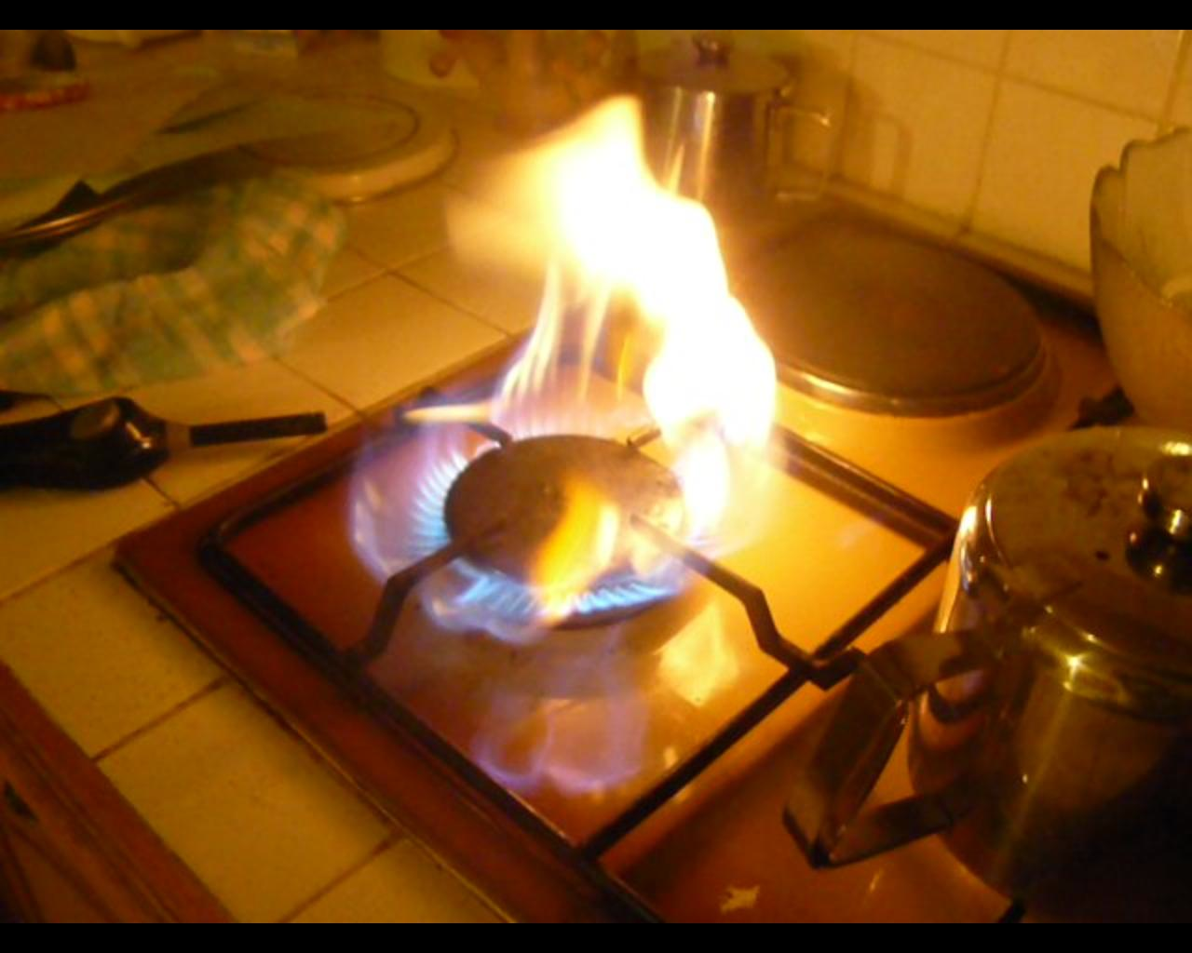
COMBUSTION
A hydrocarbon reacts with OXYGEN to produce carbon dioxide and water. Energy is also released.
propane + oxygen carbon dioxide + water
C₃H₈ + 5 O₂ 3 CO₂ + 4 H₂O
Examples: burning propane
cooking food
power vehicles
lighting candles

